Slide 1
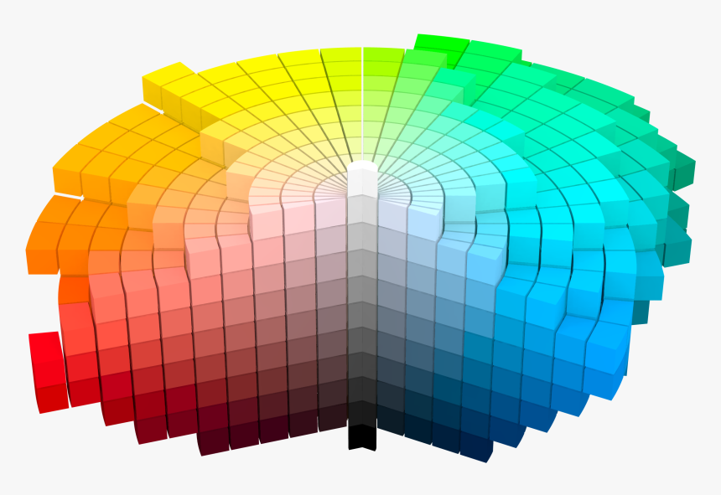
Activity 4: RGB to Spectra using PCA
Physics 301
Submitted by: Mark Jeremy G. Narag
Student Number: 2014-64423
Program: PhD Physics

Slide 2
Objectives
Compute the eigenspectra of paint pigments from the Munsell Color Chips database.
Convert a color camera into a spectral imager using principal components analysis.

Slide 3
STEP 1: Create ensemble of color signals C(λ) from Munsell color chips To do this, we apply element-by-element matrix multiplication to the reflectances of Munsell color chips R(λ) and spectral power distribution of a light source P(λ).
Here is the step-by-step reconstruction of color signal C(λ) as linear superposition of eigenspectra e(λ) and eigenspectra coefficients a
STEP 2: Compute eigenspectra e_{i}(λ) of color signal C(λ) To do this, we apply Principal Component Analysis (PCA) to color signal C(λ). After that, we check cumulative contribution of each principal components. We will use PC with atleast 95% contribution.
STEP 3: Compute transformation matrix T To do this, we need to take the matrix multiplication of camera sensitivity S(λ) and eigenspectral e(λ). See equation 5. Note that it should be T = S(λ)⨯e(λ).
STEP 4: Compute eigenspectra coefficients a from Macbeth chart To do this, we need to take the vector multiplication of camera sensitivity S(λ) and eigenspectral e(λ). See equation 5. Note that it should be T = S(λ)⨯e(λ).
STEP 5: Reconstruct color signal C(λ) for each patch of Macbeth chart To do this, we will refer to Equation 3 on estimating the color signal using eigenspectra coefficient a and eigenspectra e(λ). Remember that we usually obtain the color signal from spectral distribution of a light source P(λ) and reflectance of the color R(λ).

Slide 4
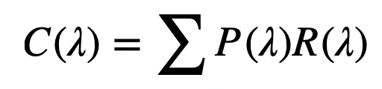
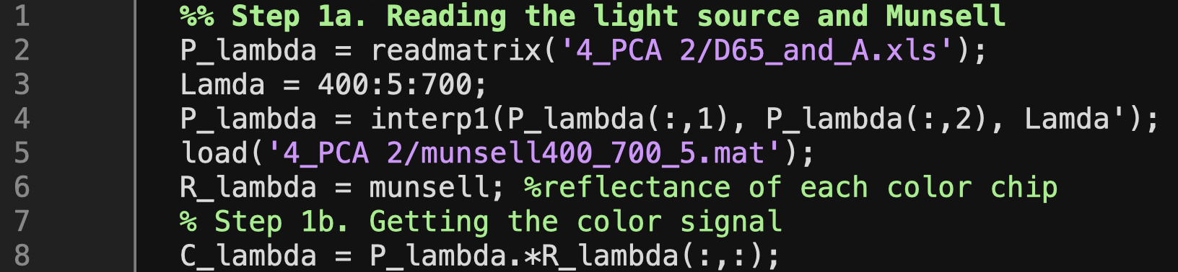
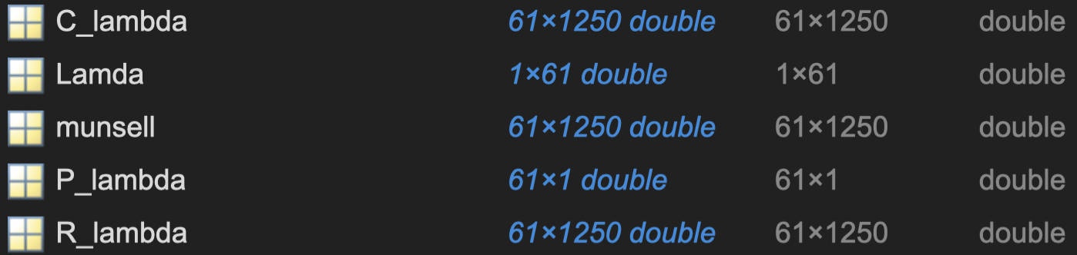
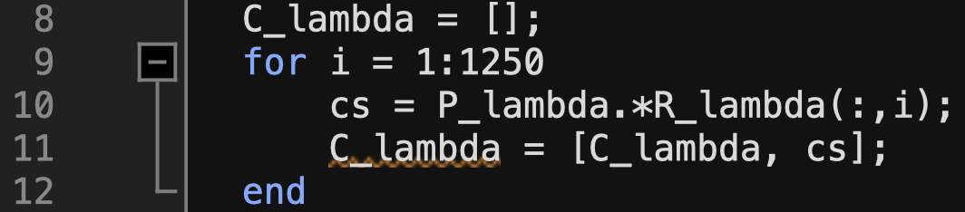
STEP 1: Create ensemble of color signals C(λ) from Munsell color chips To do this, we apply element-by-element matrix multiplication to the reflectances of Munsell color chips R(λ) and spectral power distribution of a light source P(λ).
Mathematically, color signal is given by:
(1)
In Matlab:
P_lambda(:,2) means we will use CIE Illuminant A. We still need to interpolate the data so the two vectors P_lambda and R_lambda will have the same length (λ).
Element-by-element multiplication for all Munsell color chips, as suggested by equation 1.
File sizes for sanity check:
SKL (share ko lang). As a python apologist for many years now, this is how I initially coded the color signal, it was a step-by-step process. It was only a matter of time when I discovered that you can easily implement that in Matlab. Matlab makes life easier. 😂

Slide 5
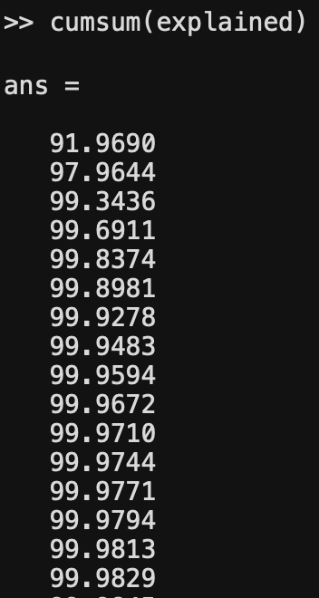
STEP 2: Compute eigenspectra e_{i}(λ) of color signal C(λ) To do this, we apply Principal Component Analysis (PCA) to color signal C(λ). After that, we check cumulative contribution of each principal components. We will use PC with atleast 95% contribution.
In Matlab:
I already explained these variables in the last activity. But here, we only need coeff, which is the eigenspectral, and explained, which gives the total contribution of each eigenspecta.
By getting the cumulative sum of the explained cumsum(explained), we can see that 2 principal components/eigenspecta already contribute to atleast 95%.
File sizes for sanity check:

Slide 6
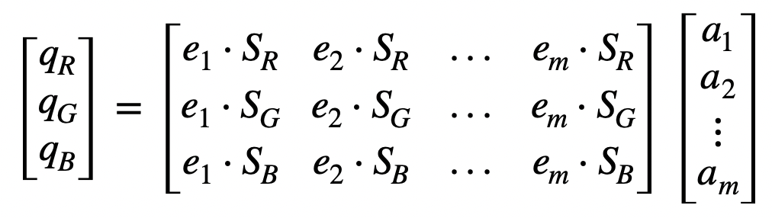
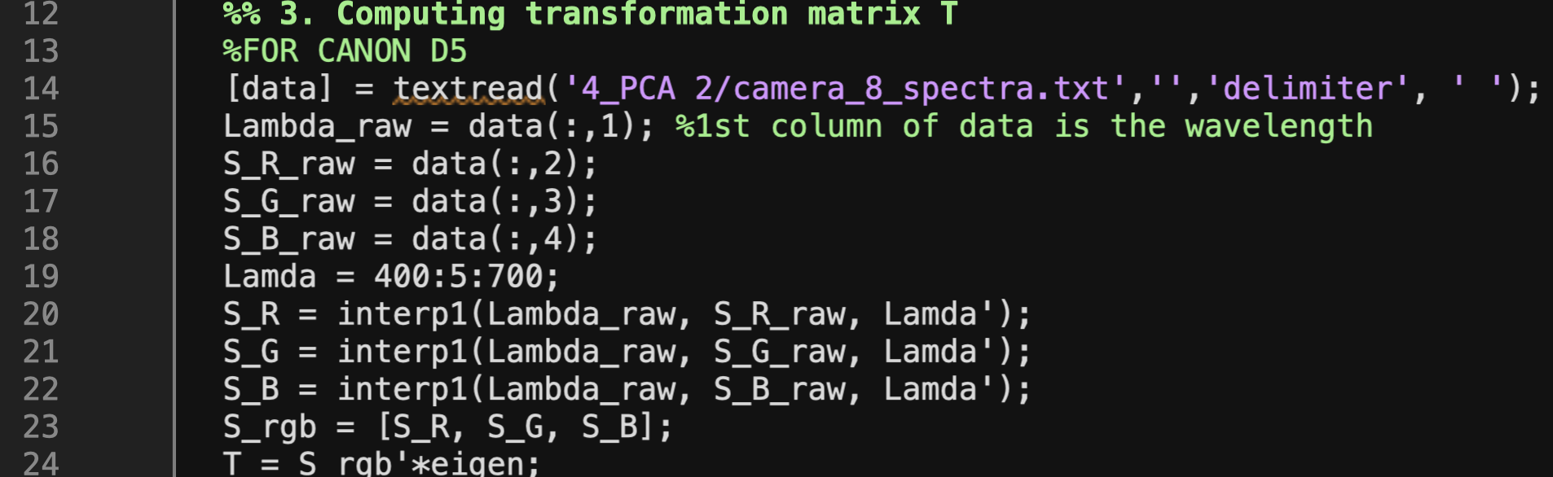
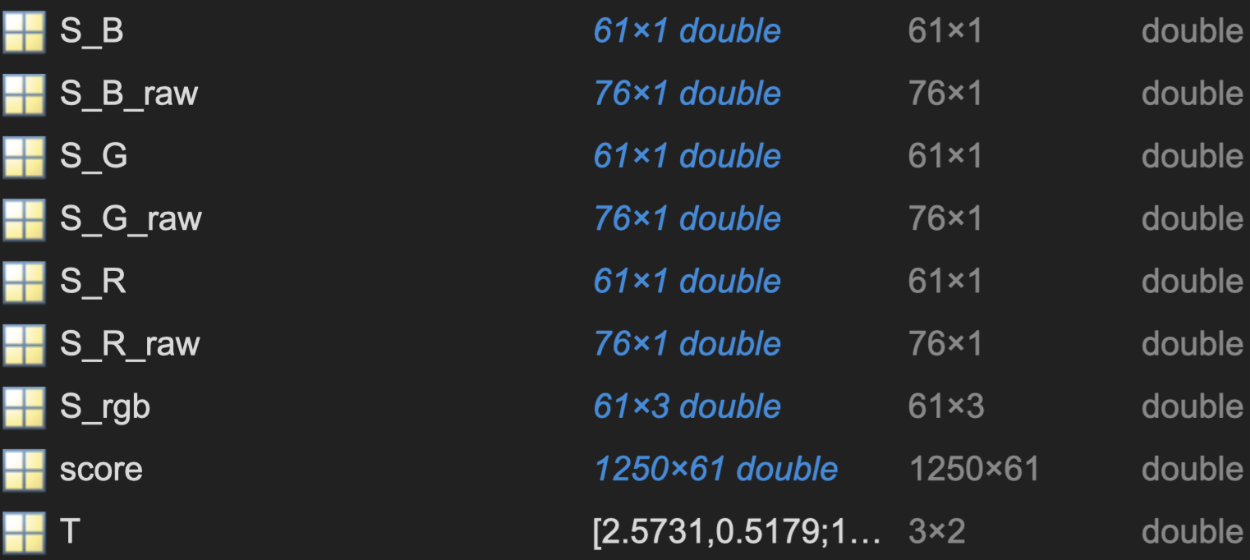
STEP 3: Compute transformation matrix T To do this, we need to take the matrix multiplication of camera sensitivity S(λ) and eigenspectral e(λ). See equation 5. Note that it should be T = S(λ)⨯e(λ).
This is transformation matrix T
Equation 5:
In Matlab:
File sizes for sanity check:
We still need to interpolate the camera sensitivity data
T = S(λ)⨯e(λ). Note that we still need to transpose S(λ) due to its original orientation. See file sizes for sanity check. T will have a final size n ⨯ m where n is the number of channels and m is the number of eigenspectral/principal components

Slide 7
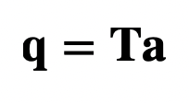
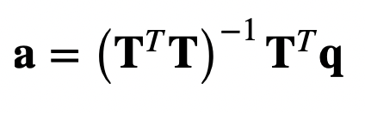
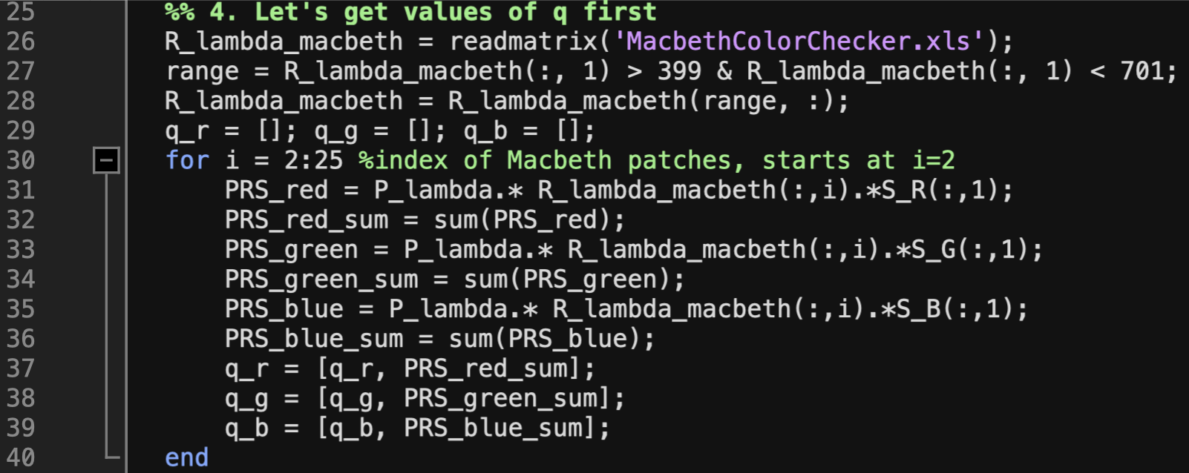
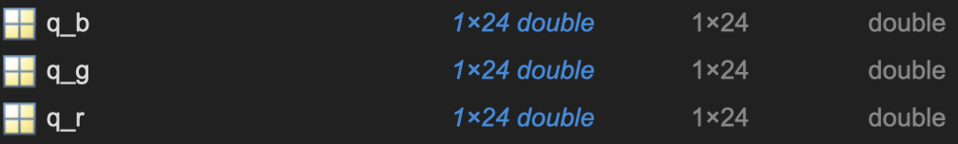
STEP 4: Compute eigenspectra coefficients a from Macbeth chart To do this, we need to take the vector multiplication of camera sensitivity S(λ) and eigenspectral e(λ). See equation 5. Note that it should be T = S(λ)⨯e(λ).
Equation 5 can be rewritten as equation 6:
(6)
Suppose we already have q, the RGB value of a color patch, and transformation matrix T that we previously obtained. We can estimate vector a using Wiener estimation given by equation 7:
(7)
In Matlab:
File sizes for sanity check:
This is the same code I used in Activity 2. I just removed the white balancing portion. We will check later the effect of this on the reconstructed color signal
I stored q in three different channels. Values of q here ranges from [0,255]. If we added the white balance equation, this ranges from [0,1].

Slide 8
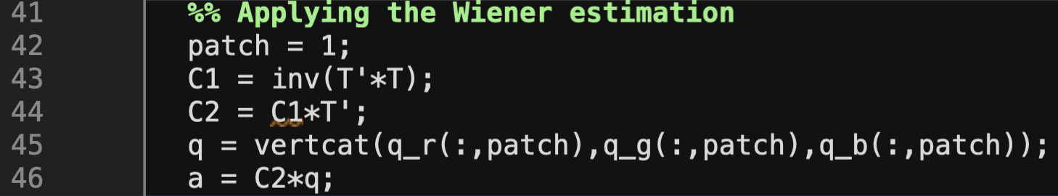
STEP 4: Compute eigenspectra coefficients a from Macbeth chart To do this, we need to take the vector multiplication of camera sensitivity S(λ) and eigenspectral e(λ). See equation 5. Note that it should be T = S(λ)⨯e(λ).
Equation 5 can be rewritten as equation 6:
(6)
Suppose we already have q, the RGB value of a color patch, and transformation matrix T that we previously obtained. We can estimate vector a using Wiener estimation given by equation 7:
(7)
In Matlab:
File sizes for sanity check:
Finally applying equation 7. This is only for a single patch/color in Macbeth chart. We will rewrite the code later so we can do it for all patches

Slide 9
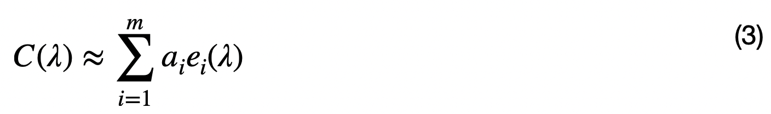
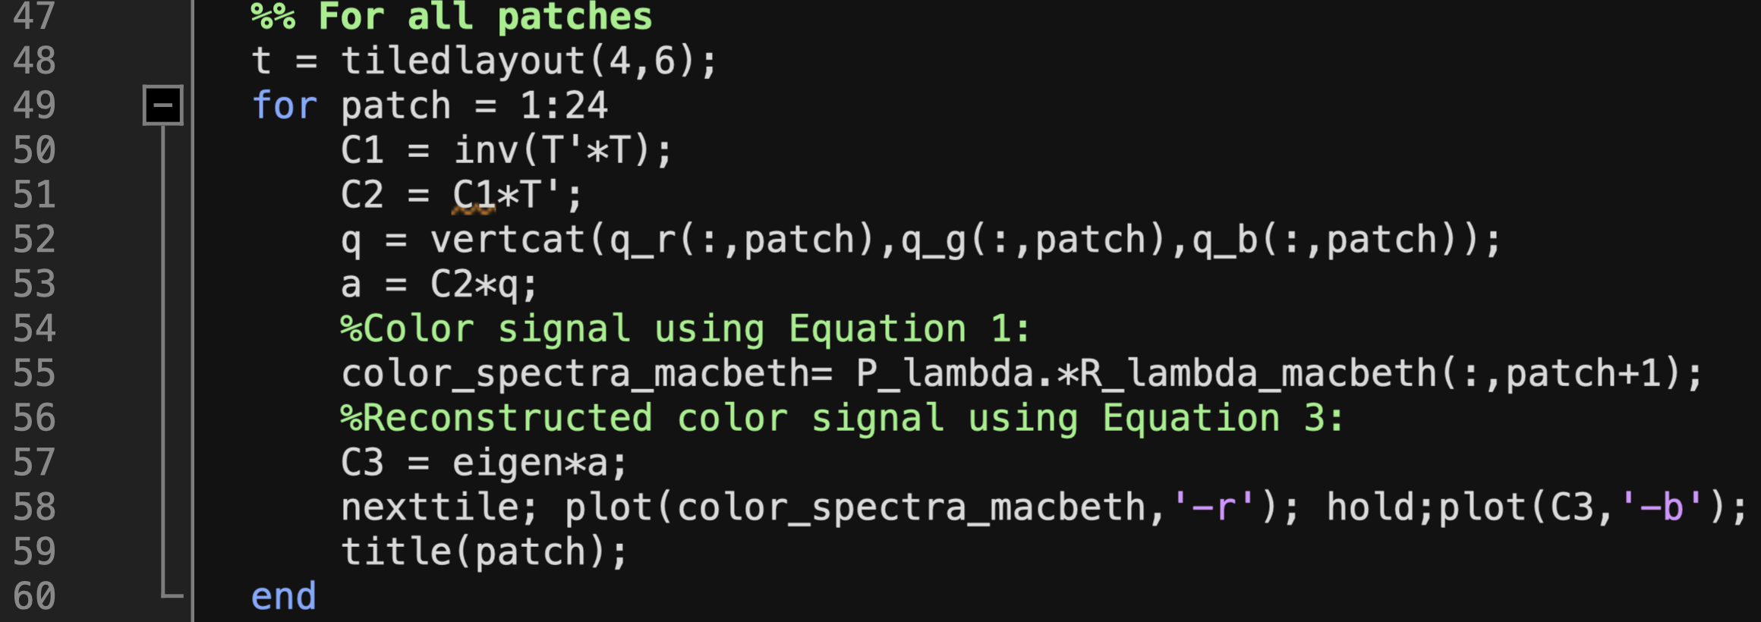
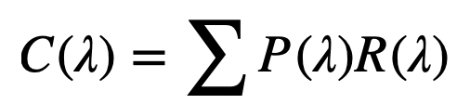
STEP 5: Reconstruct color signal C(λ) for each patch of Macbeth chart To do this, we will refer to Equation 3 on estimating the color signal using eigenspectra coefficient a and eigenspectra e(λ). Remember that we usually obtain the color signal from spectral distribution of a light source P(λ) and reflectance of the color R(λ).
Equation 3 is given by:
(3)
In Matlab:
Here, I remodified the previous code to calculate the eigenspectral coefficient a and reconstruct the color signal using equation 3 for all patches.
I also superimposed the original color signal of the Macbeth patches using equation 1:
File sizes for sanity check:

Slide 10
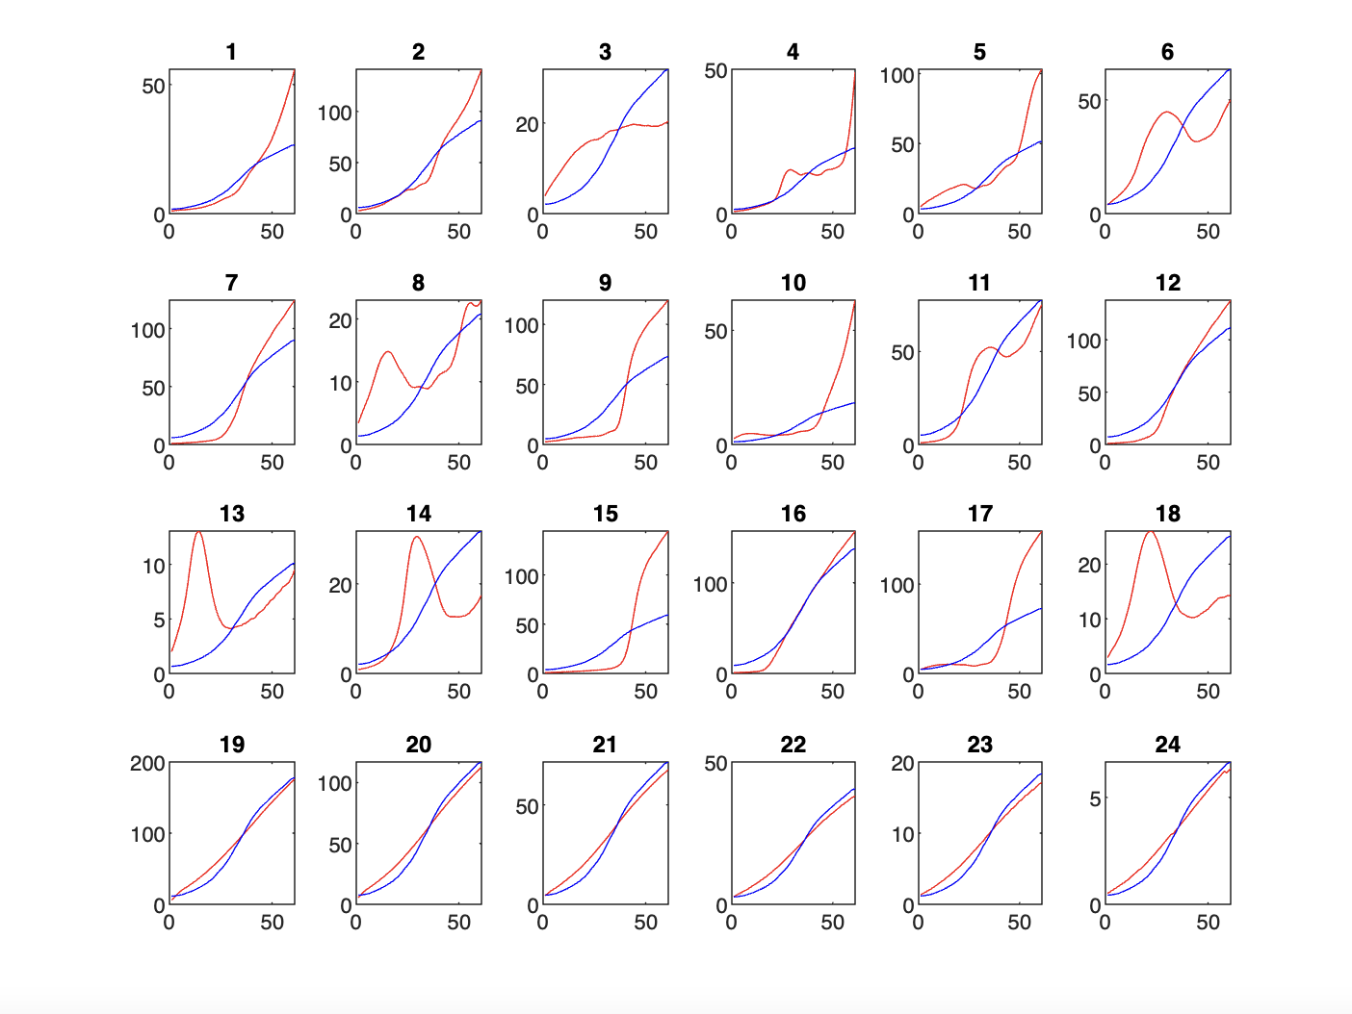
RESULTS: Reconstructed color signal (blue line) and expected color signal (red line) of each patch. The reconstructed signal is approximated from linear superposition of m=1 eigenspectra using equation 3, while expected color signal is computed from equation 1.
patch number
Equation 1:
Equation 3:
Note that this is only m=1, only 1 principal component which contributes to 91.9690% of the data explained.
We can observe big deviation on most patches. There’s a good approximation already on patches 19-24 which are the white-gray-black patches
C(λ)
λ

Slide 11
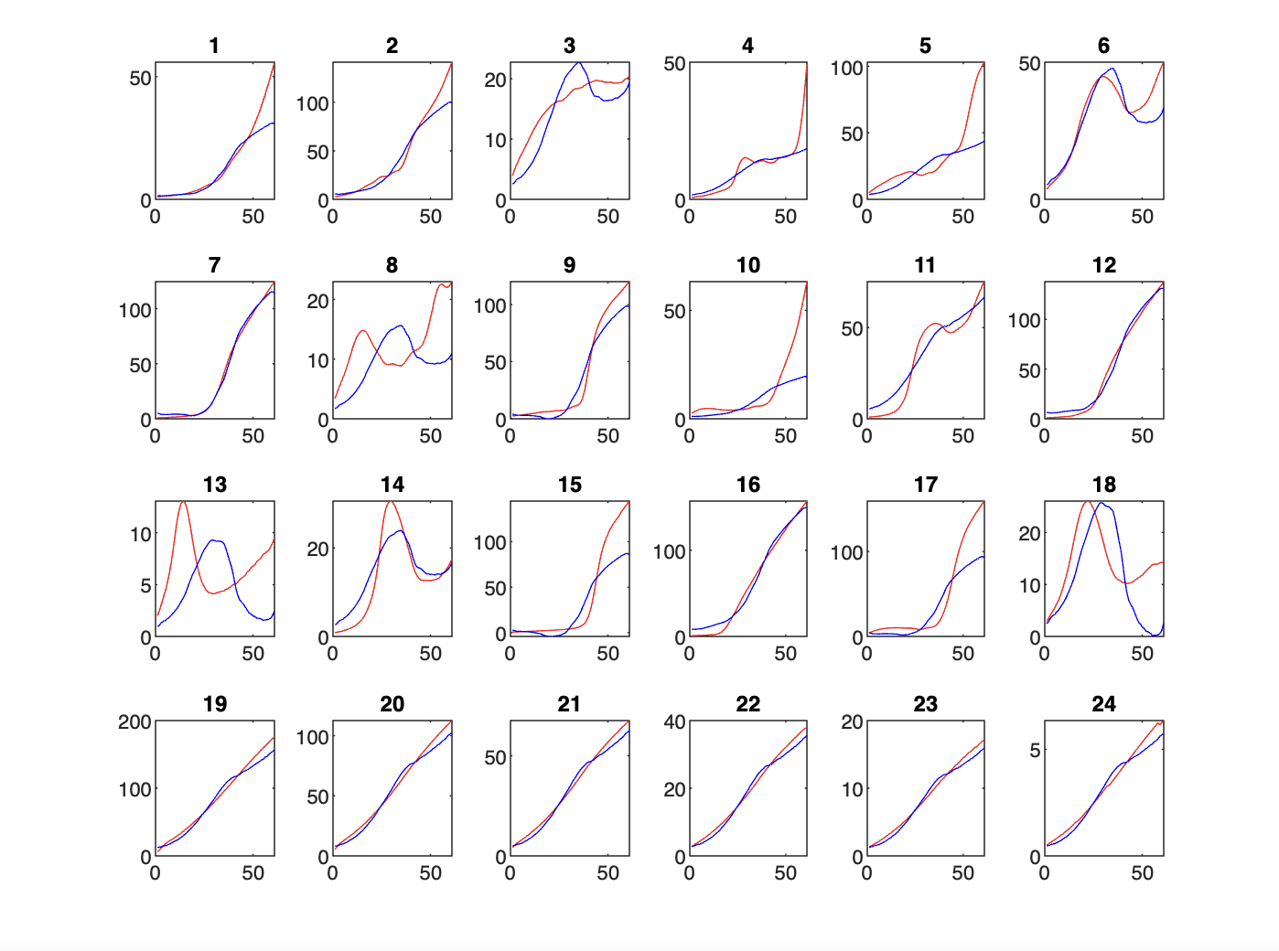
RESULTS: Reconstructed color signal (blue line) and expected color signal (red line) of each patch. The reconstructed signal is approximated from linear superposition of m=2 eigenspectra using equation 3, while expected color signal is computed from equation 1.
patch number
Equation 1:
Equation 3:
2 principal components contributes 97.9644% of the data explained. Here, we can already see big improvements on majority of the patches. Qualitatively, large deviation can still be seen on patches 8,13, and 18.
C(λ)
λ

Slide 12
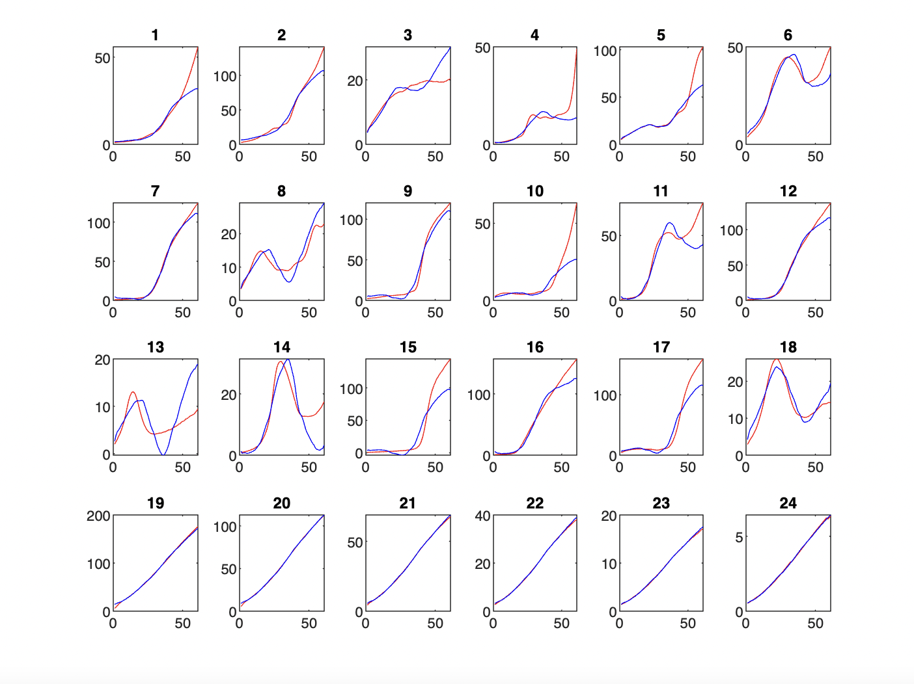
RESULTS: Reconstructed color signal (blue line) and expected color signal (red line) of each patch. The reconstructed signal is approximated from linear superposition of m=3 eigenspectra using equation 3, while expected color signal is computed from equation 1.
patch number
Equation 1:
Equation 3:
3 principal components contributes 99.3436% of the data explained. Qualitativelythere are improvements on patches 8,13, and 18. We can also see a relatively accurate reconstruction on patches 19-24.
C(λ)
λ

Slide 13
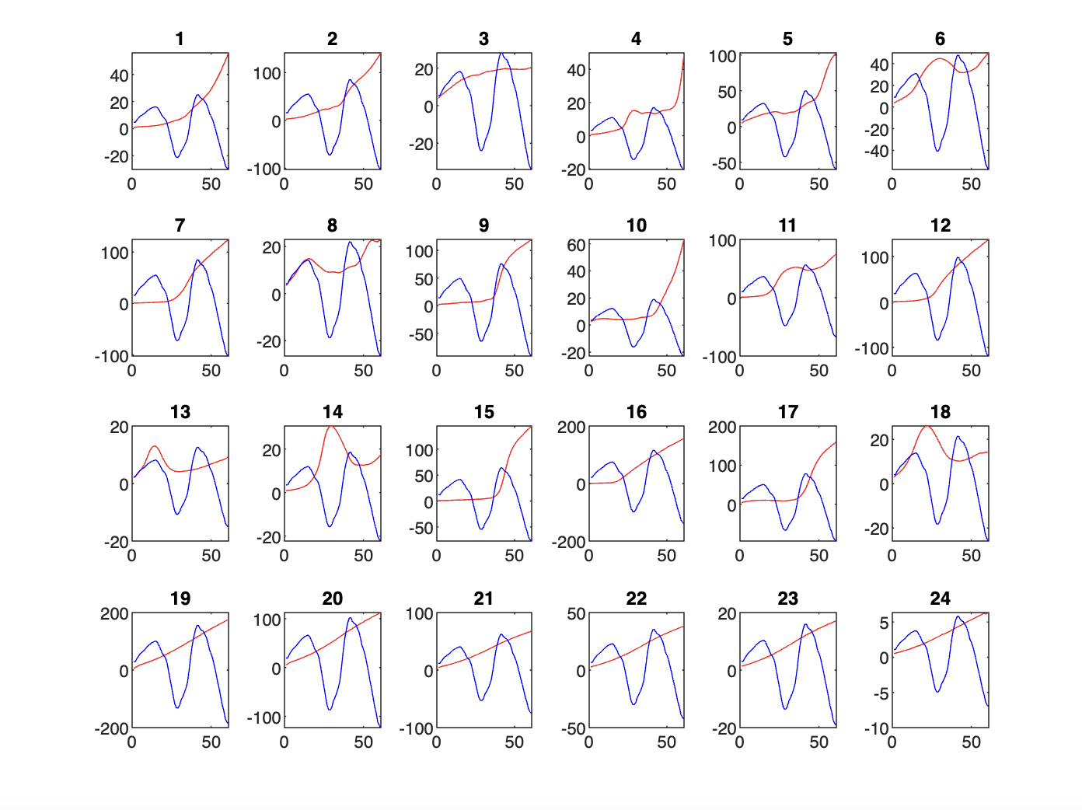
RESULTS: Reconstructed color signal (blue line) and expected color signal (red line) of each patch. The reconstructed signal is approximated from linear superposition of m=4 eigenspectra using equation 3, while expected color signal is computed from equation 1.
patch number
Equation 1:
Equation 3:
Surprisingly, beyond 3 principal components, the reconstructed color signals failed to match the expected. Here is an example for m=4. Notably, reconstructed color signal has values on the negative y-axis.
C(λ)
λ

Slide 14
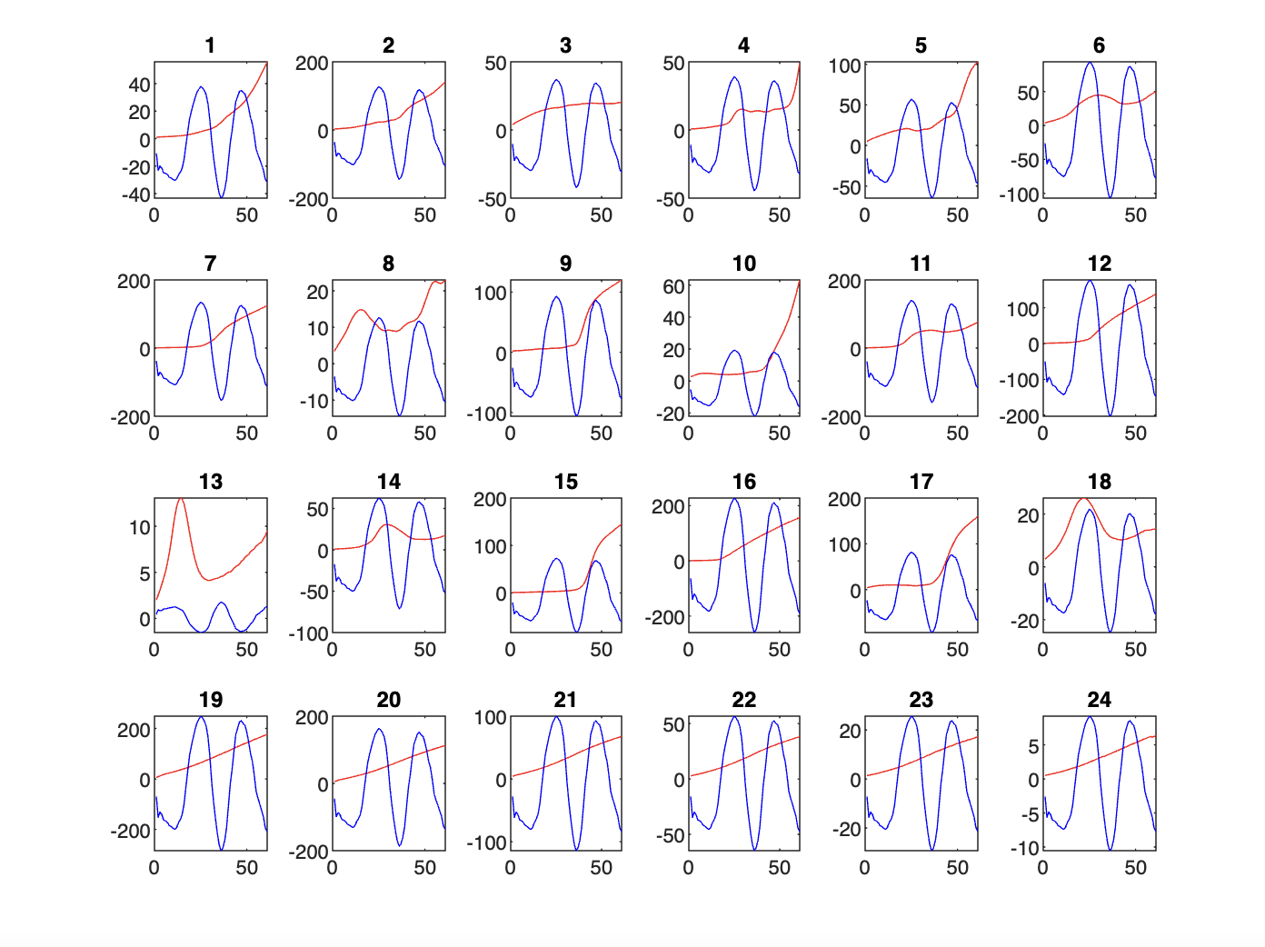
RESULTS: Reconstructed color signal (blue line) and expected color signal (red line) of each patch. The reconstructed signal is approximated from linear superposition of m=5 eigenspectra using equation 3, while expected color signal is computed from equation 1.
patch number
Equation 1:
Equation 3:
Here’s another example for m=5. It keeps giving 2 peaks.
I have consulted some of my classmates (Jonel and Chris) and they also have the same observation.
I don’t know yet why.
C(λ)
λ

Slide 15
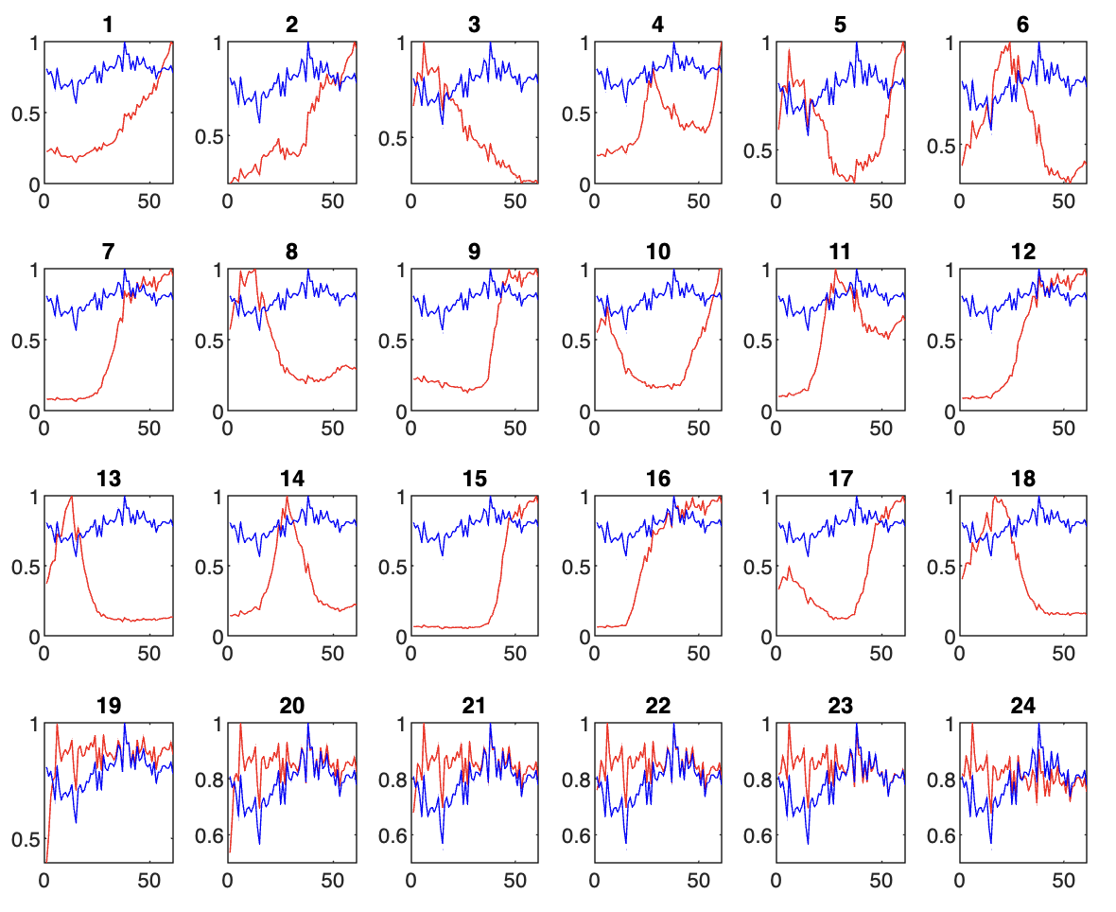
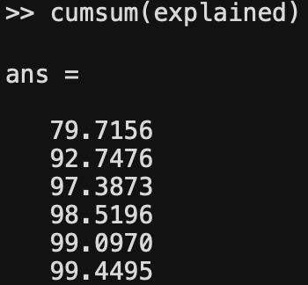
ADDITIONAL RESULTS: I tried it on actual Macbeth RGB values I obtained from the lab using LED light source and Olympus camera
patch number
Reconstructed color signal (blue line) and expected color signal (red line) of each patch. I normalize the color signals here. This is for m=1.
C(λ)
λ

Slide 16
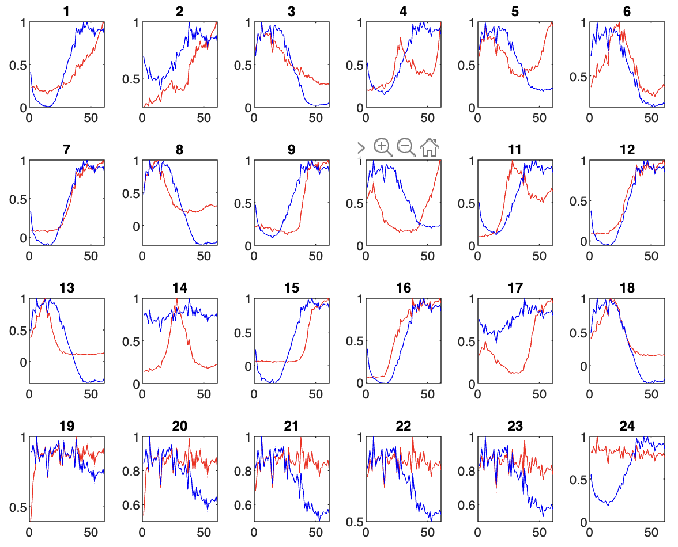
ADDITIONAL RESULTS: I tried it on actual Macbeth RGB values I obtained from the lab using LED light source and Olympus camera
patch number
Reconstructed color signal (blue line) and expected color signal (red line) of each patch. I normalize the color signals here. This is for m=2.
C(λ)
λ

Slide 17
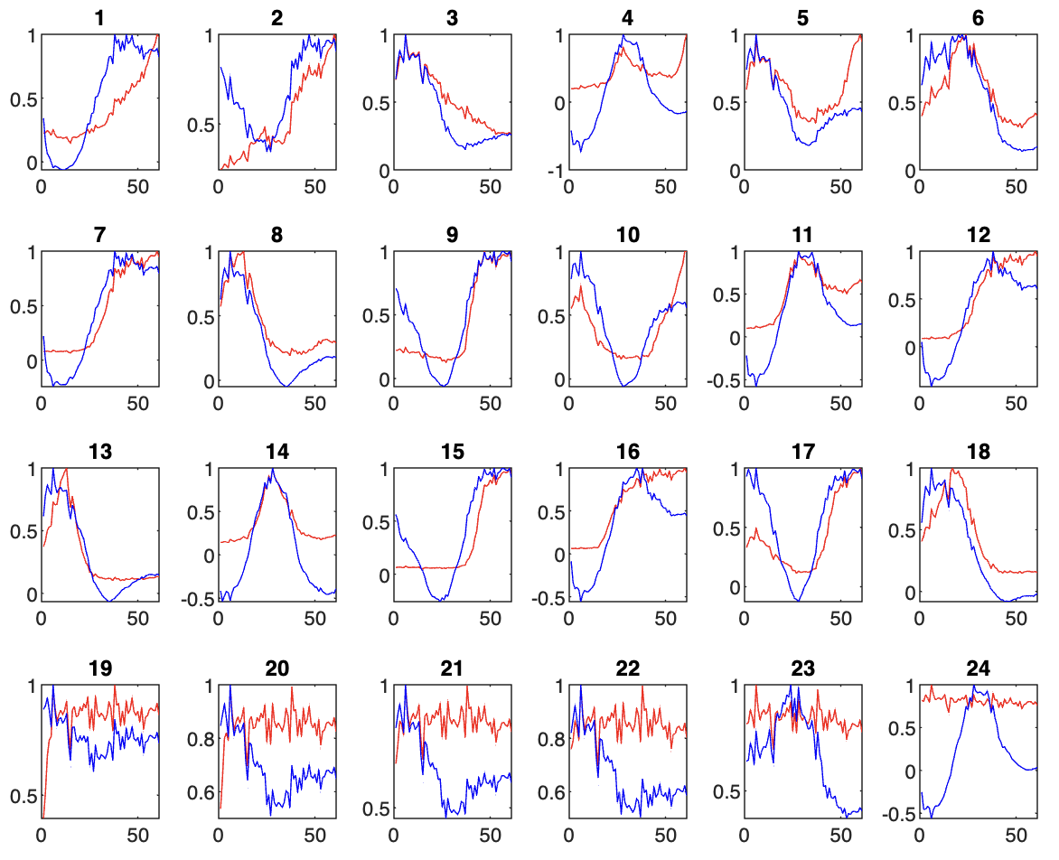
ADDITIONAL RESULTS: I tried it on actual Macbeth RGB values I obtained from the lab using LED light source and Olympus camera
patch number
Reconstructed color signal (blue line) and expected color signal (red line) of each patch. I normalize the color signals here. This is for m=3.
C(λ)
λ

Slide 18
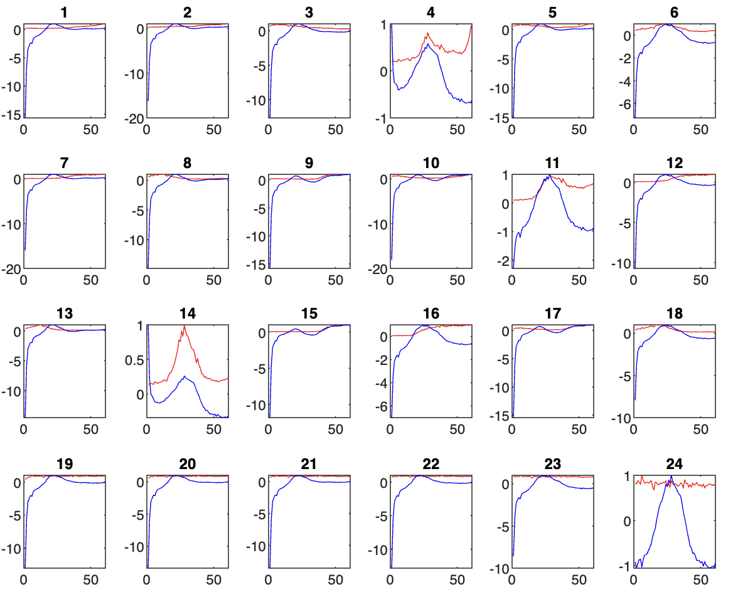
ADDITIONAL RESULTS: I tried it on actual Macbeth RGB values I obtained from the lab using LED light source and Olympus camera
patch number
Reconstructed color signal (blue line) and expected color signal (red line) of each patch. I normalize the color signals here. This is for m=4.
C(λ)
λ

Slide 19
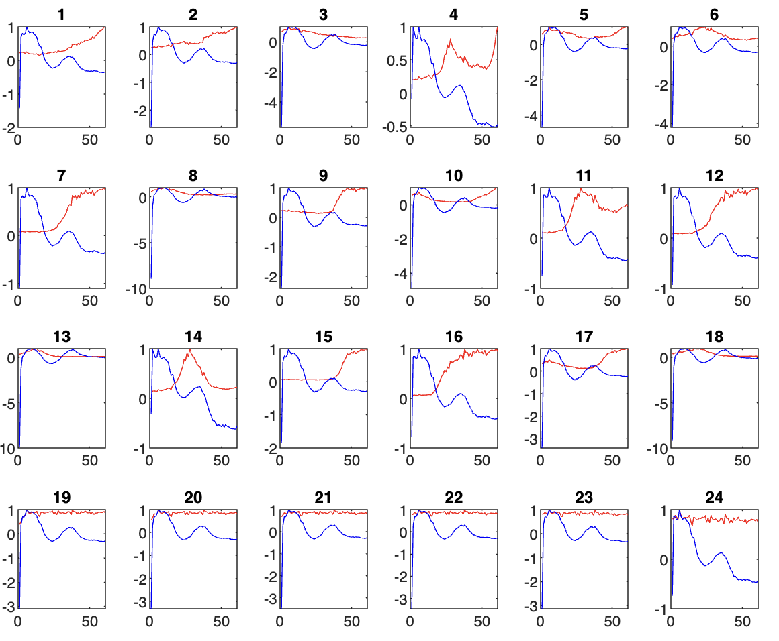
ADDITIONAL RESULTS: I tried it on actual Macbeth RGB values I obtained from the lab using LED light source and Olympus camera
patch number
Reconstructed color signal (blue line) and expected color signal (red line) of each patch. I normalize the color signals here. This is for m=5.
C(λ)
λ

Slide 20
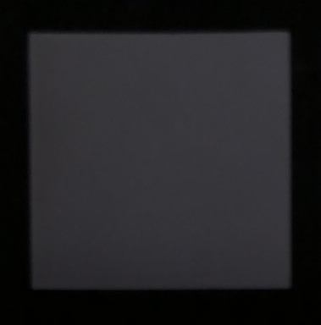
ADDITIONAL RESULTS: Actual Macbeth values and comments
Average RGB values from GIMP color picker (5 data points per patch - Q1-Q4, Center)
PATCHES | R | G | B
1 | 13 | 7.8 | 1.8
2 | 44.6 | 29.6 | 30.6
3 | 11.2 | 19.6 | 39
4 | 10.6 | 16.4 | 0.2
5 | 21.8 | 22.8 | 46.8
6 | 22.4 | 43.4 | 50.2
7 | 44.6 | 25 | 0
8 | 1.4 | 8.4 | 34.4
9 | 42.8 | 10.6 | 17.2
10 | 6.4 | 2.4 | 12.4
11 | 37.4 | 43.8 | 4.2
12 | 54.4 | 39.2 | 0
13 | 0 | 4.4 | 19
14 | 8.6 | 25.6 | 5.4
15 | 32.6 | 0.4 | 2.2
16 | 59.6 | 51.2 | 0
17 | 36.8 | 7.6 | 32.6
18 | 0.2 | 19 | 41
19 | 53 | 51.8 | 56.8
20 | 41.8 | 41.6 | 50.6
21 | 28.2 | 28.4 | 37
22 | 15.6 | 16.6 | 20.6
23 | 4.6 | 6.2 | 5.8
24 | 1.2 | 1.6 | 0.2
Q2
Q1
Center
Q3
Q4
Conclusion:
While the rendered color signals from actual macbeth values are not as smooth and as accurate as the synthetic values, we can definitely see the same result where it fails to reconstruct the signal for PC greater than 3 – for the reason I still can’t figure out.

Slide 21

CRITERIA | QUALIFICATIONS | SCORE
Technical correctness | Met all objectives. Results are complete. Results are verifiably correct. Understood the lesson. | 30
Quality of presentation. | All text and images are of good quality. A picture or diagram of the setup is shown (if the activity has one). Code has sufficient comments and guides. All plots are properly labeled and are visually understandable. The report is clear. | 30
Reflection | Explained the validity of results. Discussed what went right or wrong in the activity. Justified the self score. Acknowledged sources (e.g. persons consulted, references, etc.) | 30
Ownership | Applied the technique on other data (actual macbeth data) Discovered limitations in the technique (Yes, it failed for higher PCs) Introduced improvements to the technique (Wasn’t able to, willing to know why) | 9?
99

